Slide 1
Welcome to JCPenney’s Fine Jewelry Department!
Presented by:
Adrianna Brown, Jason Chen, Jennifer Kaite, Mianmian Li

Slide 2
Careplans
Used to protect customers jewelry
Hard to keep track of customers repairs
Sometimes can’t find customer repairs or status of repair
Causes customers dissatisfaction

Slide 3
Solution: Database
Business Value:
The database will provide better customer service and increased sales. One specific sales increase will be in the sale of care plans. It is very important to sell these plans because it creates pure profit for the company. These plans are directly related to customer service and sales.

Slide 4
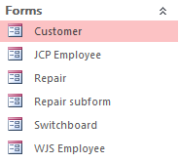
Forms:

Slide 5
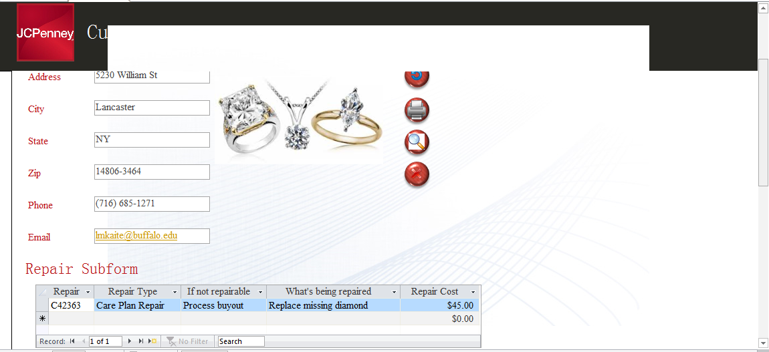
Customer Form:

Slide 6
JCP Employee Form:

Slide 7
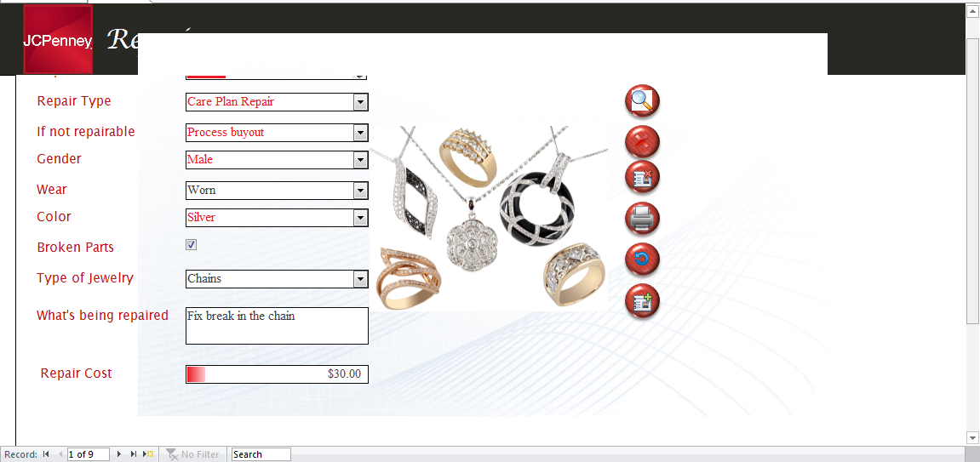
Repair Form:

Slide 8
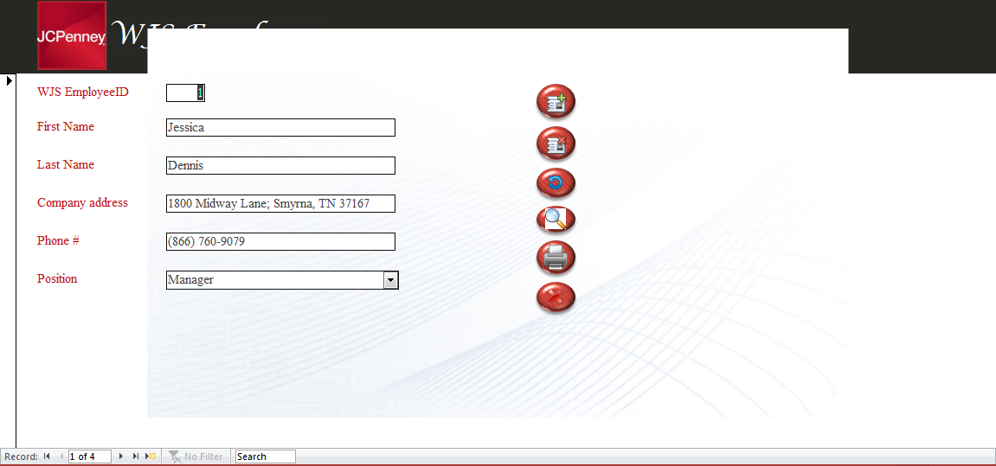
WJS Employee Form:

Slide 9
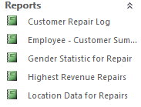
Reports:

Slide 10
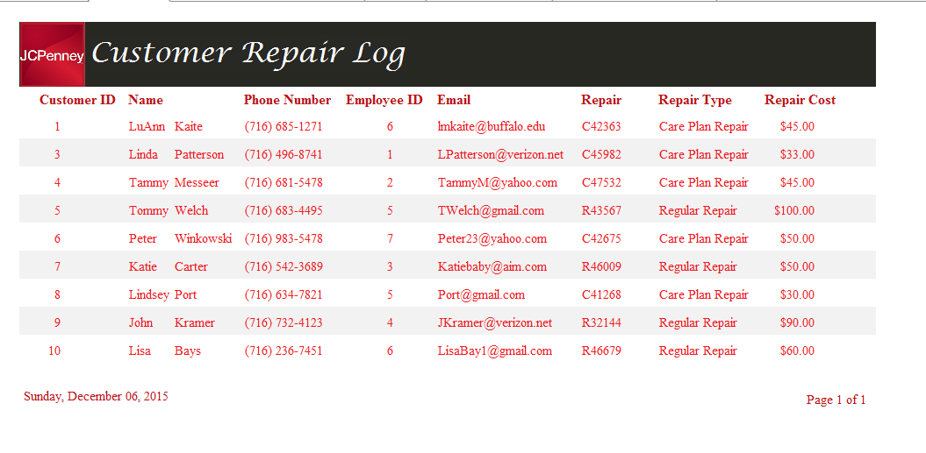
Customer Repair Log:

Slide 11
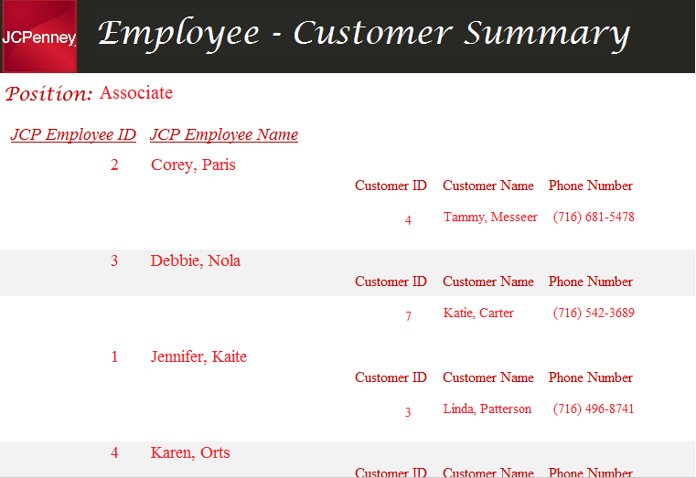
Employee/Customer Summary:

Slide 12
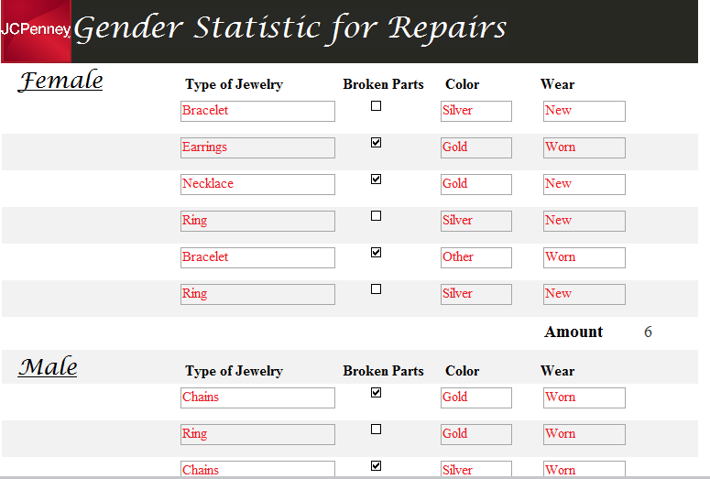
Gender Statistics:

Slide 13
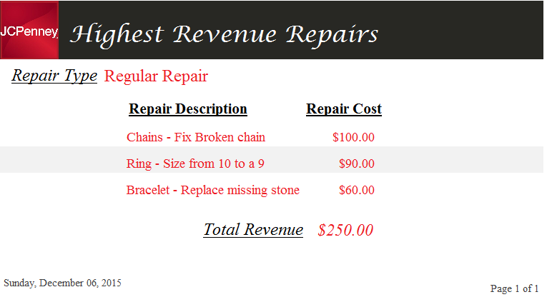
Revenue Report:

Slide 14
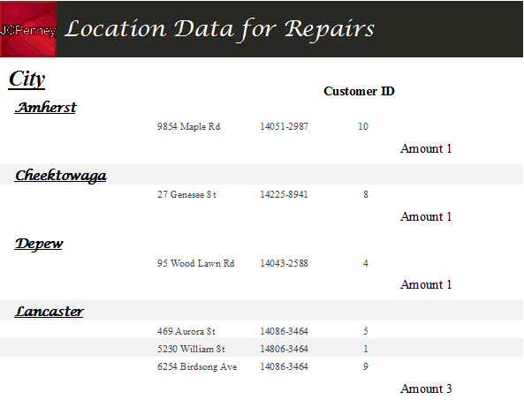
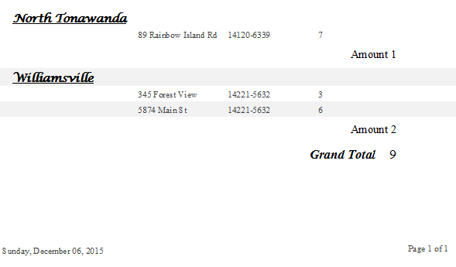
Customer Location Report:

Slide 15
Questions…?

